Slide 1
Complementary Resistive Switch
Linn, Eike, Roland Rosezin, Carsten Kügeler, and Rainer Waser. "Complementary resistive switches for passive nanocrossbar memories." Nature materials 9, no. 5 (2010): 403.

Slide 2
Sneak Path Problem and Destructive Readout
CRS state | Memristive element A | Memristive element B | Resistance CRS
0 | HRS | LRS | ≈HRS
1 | LRS | HRS | ≈HRS
ON | LRS | LRS | LRS+LRS; only during read operation
OFF | HRS | HRS | ≫HRS; only in initial state
Linn, Eike, Roland Rosezin, Carsten Kügeler, and Rainer Waser. "Complementary resistive switches for passive nanocrossbar memories." Nature materials 9, no. 5 (2010): 403.

Slide 3
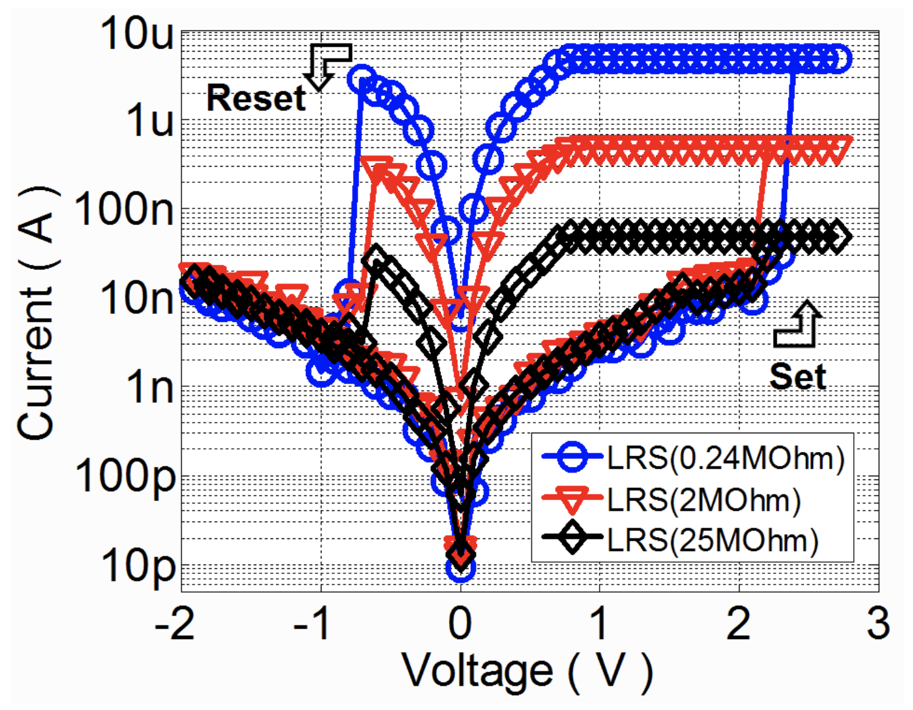
AlON Filamentary SPICE Model (Fitted)
Kim, Wanki, Sung Il Park, Zhiping Zhang, and Simon Wong. "Current Conduction Mechanism of Nitrogen-Doped AlO_{x} RRAM." IEEE Transactions on Electron Devices 61, no. 6 (2014): 2158-2163.
Reuben, John, Dietmar Fey, and Christian Wenger. "A modeling methodology for Resistive RAM based on Stanford-PKU model with extended multilevel capability." IEEE Transactions on Nanotechnology 18 (2019): 647-65
Wang, Tianshi, and Jaijeet Roychowdhury. "Well-posed models of memristive devices." arXiv preprint arXiv:1605.04897 (2016).
Guan, Ximeng, Shimeng Yu, and H-S. Philip Wong. "A SPICE compact model of metal oxide resistive switching memory with variations." IEEE electron device letters 33, no. 10 (2012): 1405-1407.

Slide 4
AlON Filamentary SPICE Model (Fitted)
Kim, Wanki, Sung Il Park, Zhiping Zhang, and Simon Wong. "Current Conduction Mechanism of Nitrogen-Doped AlO_{x} RRAM." IEEE Transactions on Electron Devices 61, no. 6 (2014): 2158-2163.
Reuben, John, Dietmar Fey, and Christian Wenger. "A modeling methodology for Resistive RAM based on Stanford-PKU model with extended multilevel capability." IEEE Transactions on Nanotechnology 18 (2019): 647-65
Wang, Tianshi, and Jaijeet Roychowdhury. "Well-posed models of memristive devices." arXiv preprint arXiv:1605.04897 (2016).
Guan, Ximeng, Shimeng Yu, and H-S. Philip Wong. "A SPICE compact model of metal oxide resistive switching memory with variations." IEEE electron device letters 33, no. 10 (2012): 1405-1407.

Slide 5
Non-destructive Read: Capacitive Voltage Divider with Voltage Readout
Tappertzhofen, S., E. Linn, L. Nielen, R. Rosezin, F. Lentz, R. Bruchhaus, I. Valov, U. Böttger, and R. Waser. "Capacity based nondestructive readout for complementary resistive switches." Nanotechnology 22, no. 39 (2011): 395203.

Slide 6
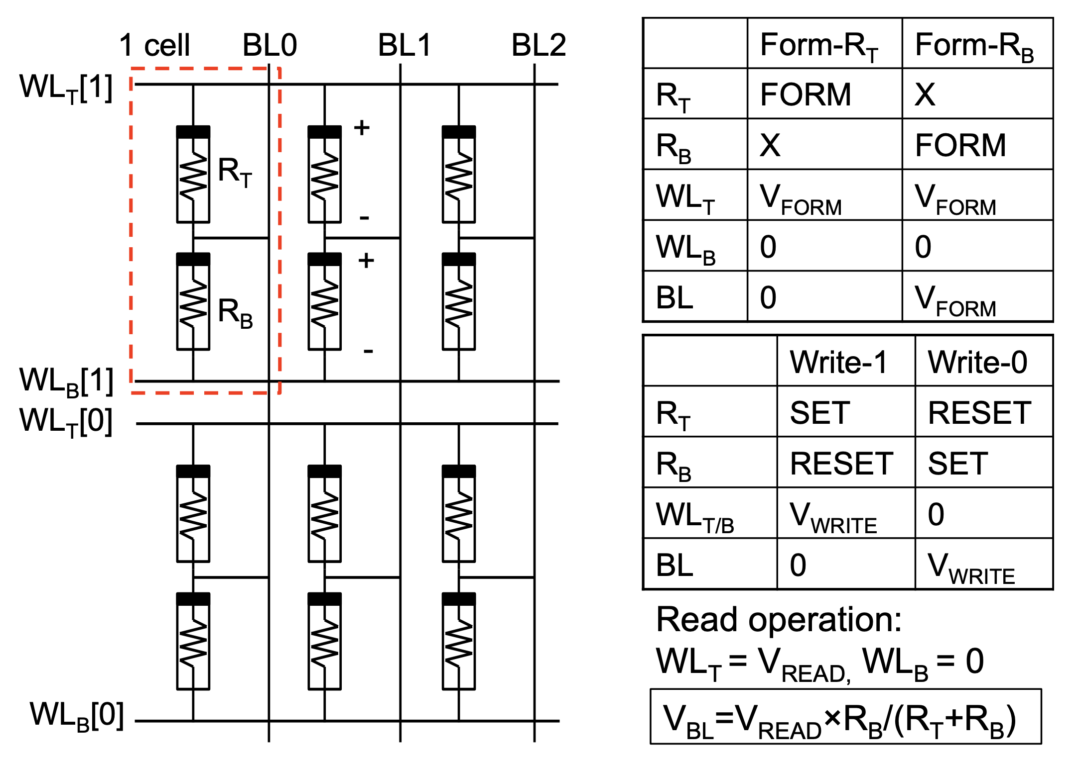
Non-destructive Read: Resistive Voltage Divider with Voltage Readout
Chiu, Pi-Feng, and Borivoje Nikolić. "A differential 2R crosspoint RRAM array with zero standby current." IEEE Transactions on Circuits and Systems II: Express Briefs 62, no. 5 (2014): 461-465.

Slide 7
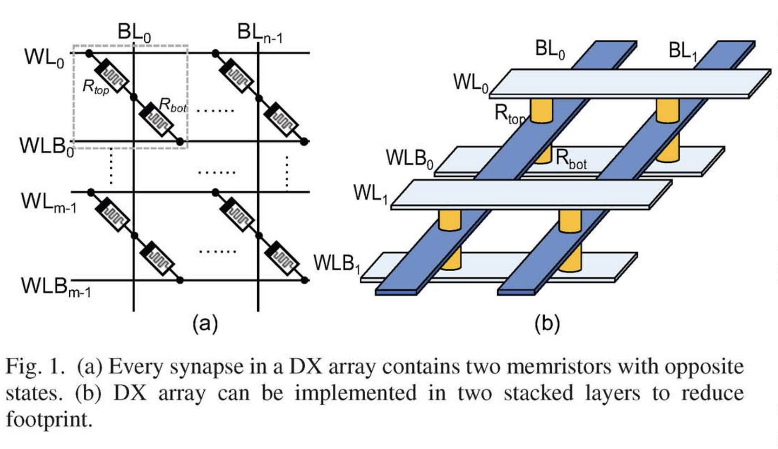
Differential 2R Crosspoint (DX) Array
Chiu, Pi-Feng, and Borivoje Nikolić. "A differential 2R crosspoint RRAM array with zero standby current." IEEE Transactions on Circuits and Systems II: Express Briefs 62, no. 5 (2014): 461-465.
Diagram of NOR flash array

Slide 8
Applications
Storage-class/embedded memory: MLC, selector-less (3D!), low-power (high HRS!)
Analog addition and matrix multiplication
Control plane memory

Slide 9
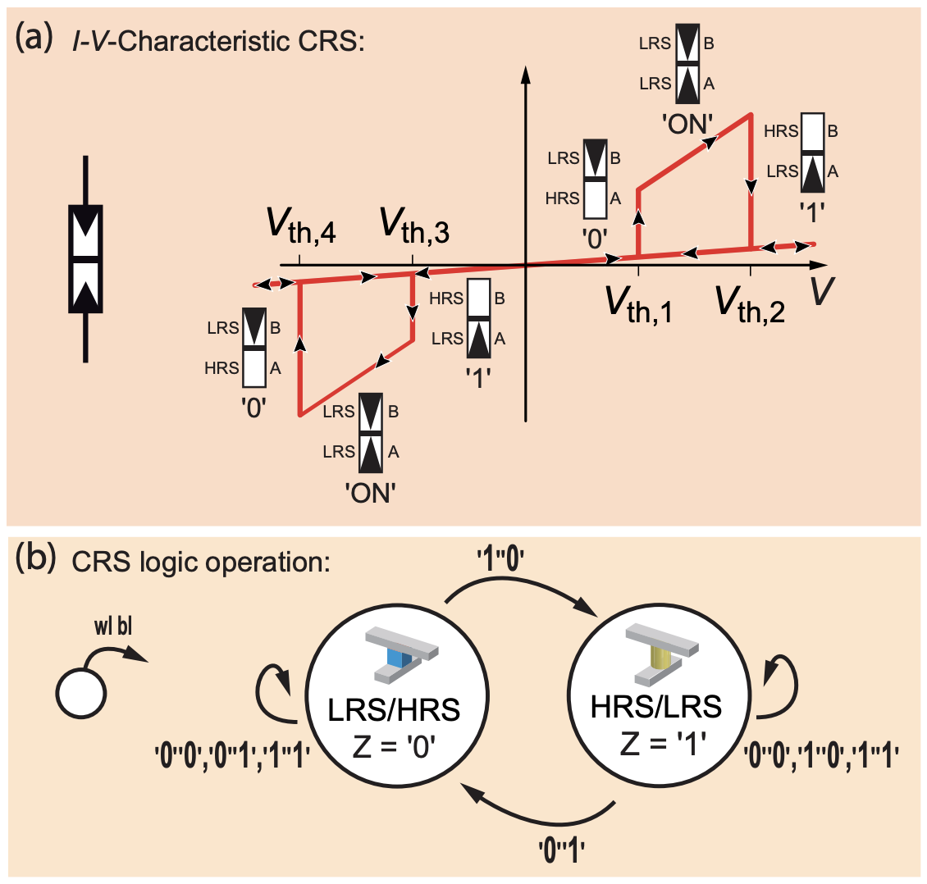
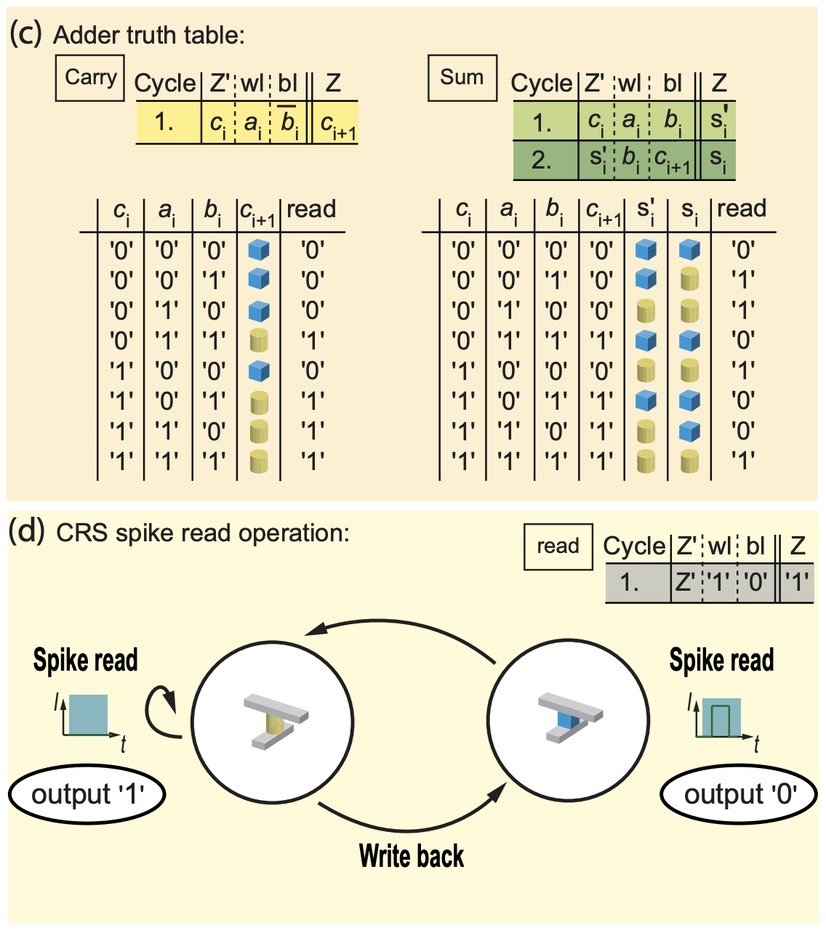
CRS Addition Unit
Siemon, Anne, Stephan Menzel, Rainer Waser, and Eike Linn. "A complementary resistive switch-based crossbar array adder." IEEE journal on emerging and selected topics in circuits and systems 5, no. 1 (2015): 64-74.

Slide 10
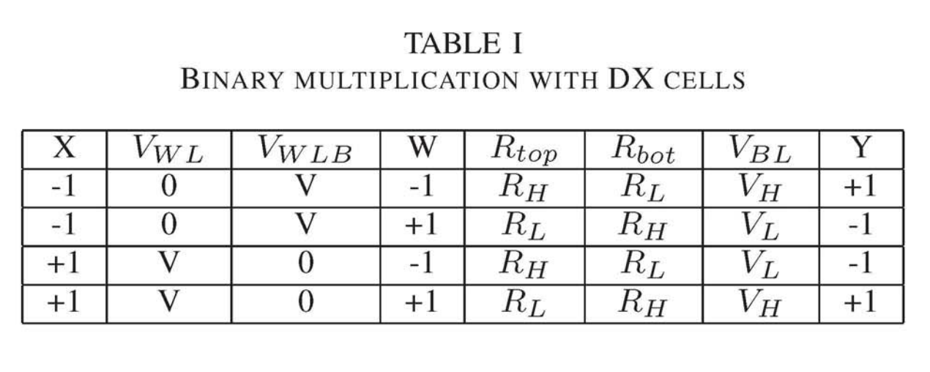
Binarized DX Crosspoint MAC Unit
Table I lists the four cases of multiplying two binary numbers (+1 and -1), where X is the input, W is the weight, and Y is the output. To represent an input of -1, WL is tied to ground and WLB is connected to V. The connections are flipped when representing input of +1. For different weight values, the top memristor (R_{top}) is programmed to HRS (R_{H}) when W is -1 and to LRS (Rd when W is +1. The bottom memristor (R_{bot}) is programmed in the opposite fashion. As a result, the output voltage on BL matches the truth table perfectly. V_{H} = V (RH / (RH + RL)) corresponds to Y = +1 and V_{L} = V (RL / (RH + RL)) corresponds to Y = -1.
Accumulation value works out with HRS/LRS > 10⁵: activate all
Chiu, Pi-Feng, Won Ho Choi, Wen Ma, Minghai Qin, and Martin Lueker-Boden. "A Binarized Neural Network Accelerator with Differential Crosspoint Memristor Array for Energy-Efficient MAC Operations." In 2019 IEEE International Symposium on Circuits and Systems (ISCAS), pp. 1-5. IEEE, 2019.

Slide 11
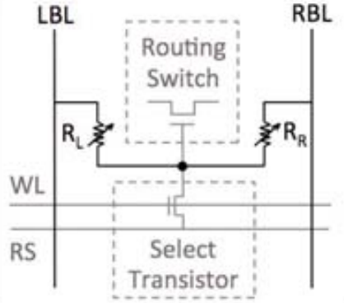
2R vs. 1T2R: Programmable Voltage Divider
Alternative:
Program directly from LBL to RBL
No programming WL needed for full 3D
Direct control plane memory
Small static current w/high HRS
Liauw, Young Yang, Zhiping Zhang, Wanki Kim, Abbas El Gamal, and S. Simon Wong. "Nonvolatile 3D-FPGA with monolithically stacked RRAM-based configuration memory." In 2012 IEEE International Solid-State Circuits Conference, pp. 406-408. IEEE, 2012.

Slide 12
Fabrication Ideas
CRS Device

Slide 13
Step 1: Large 1R ALD RRAM (80um x 80um)
Steps 1-4 need to be done consecutively without breaking vacuum
1. Deposit 20nm TiN with ALD on fiji1/2
Plasma TiN recipe
0.6-0.7 A/cycle
Tetrakis(dimethylamido)titanium(IV) @ 75C, N2 plasma (which order in recipe?)
2. Deposit 4nm AlN with ALD on fiji1/2
Plasma AlN recipe
TMA, N2 plasma
0.8 A/cycle
3. Deposit 5nm Al2O3 with ALD on fiji1/2
Thermal Al2O3 recipe (standard)
TMA, DI water @ 200C (or O2 plasma?)
0.92 A/cycle = 50 cycles
4. Deposit 20nm TiN with ALD on fiji1/2
Plasma TiN recipe
0.6-0.7 A/cycle
Tetrakis(dimethylamido)titanium(IV) @ 75C, N2 plasma (which order in recipe?)
5. Anneal @ 400C for 15 minutes for diffusion
6. Deposit top contact material
7. Pattern and etch

Slide 14
Step 2: Large 2R ALD RRAM (80um x 80um)
Do 1R fabrication twice in reverse order for anti-serial configuration
Will this work?
Can AlN grow on AlO?
If not, can make structures separately and share top contact

Slide 15
Step 3++: Selector-less Xpoint Arrays
Many configurations to try
Start simple and try more complicated
Simplest: CRS array
More complex: DX array
Try with small array sizes and large cells
Scale down, possibly use e-beam to go sub-micron?

